Slide 1
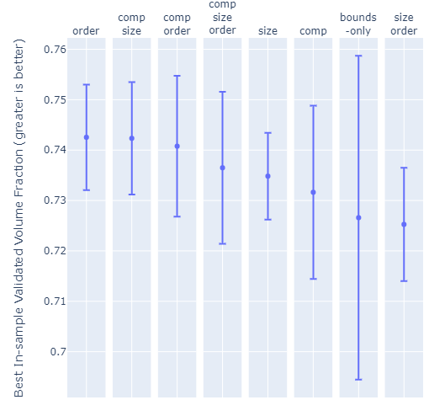
Average Num. Constraints | 2.5 |  |  |  | 1
Num. Constraints | 2 | 2 | 3 | 3 | 1 | 1 | 0 | 2

Slide 2
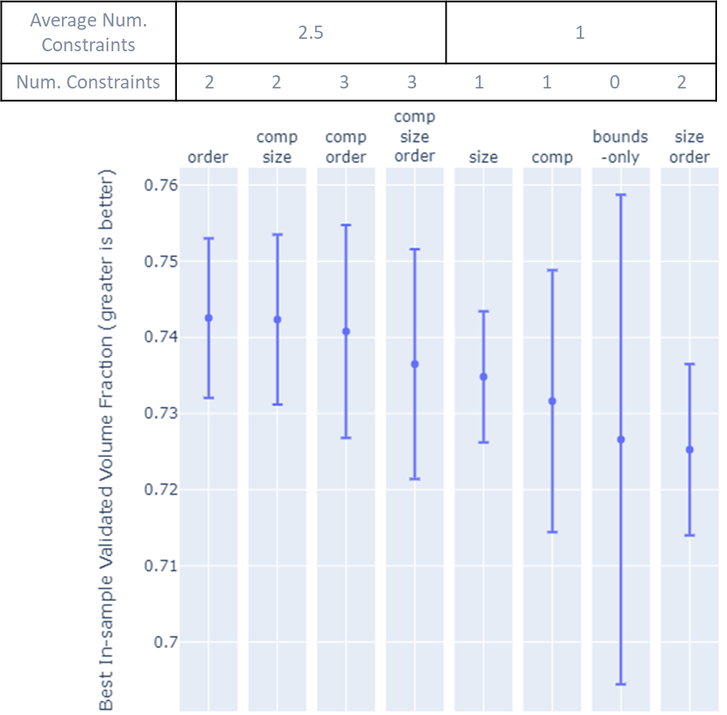

Slide 3
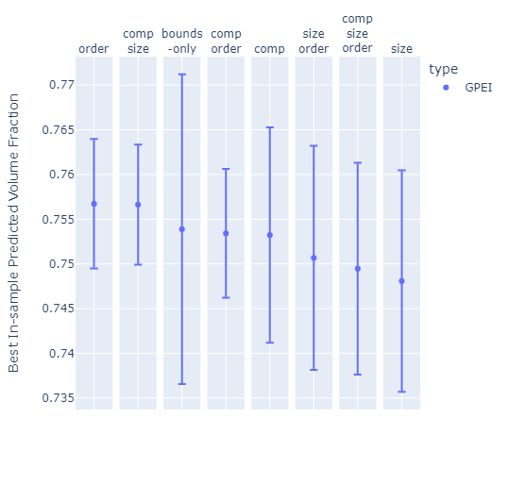
Average Num. Constraints | 1.75 |  |  |  | 1.75
Num. Constraints | 2 | 2 | 0 | 3 | 1 | 2 | 3 | 1

Slide 4
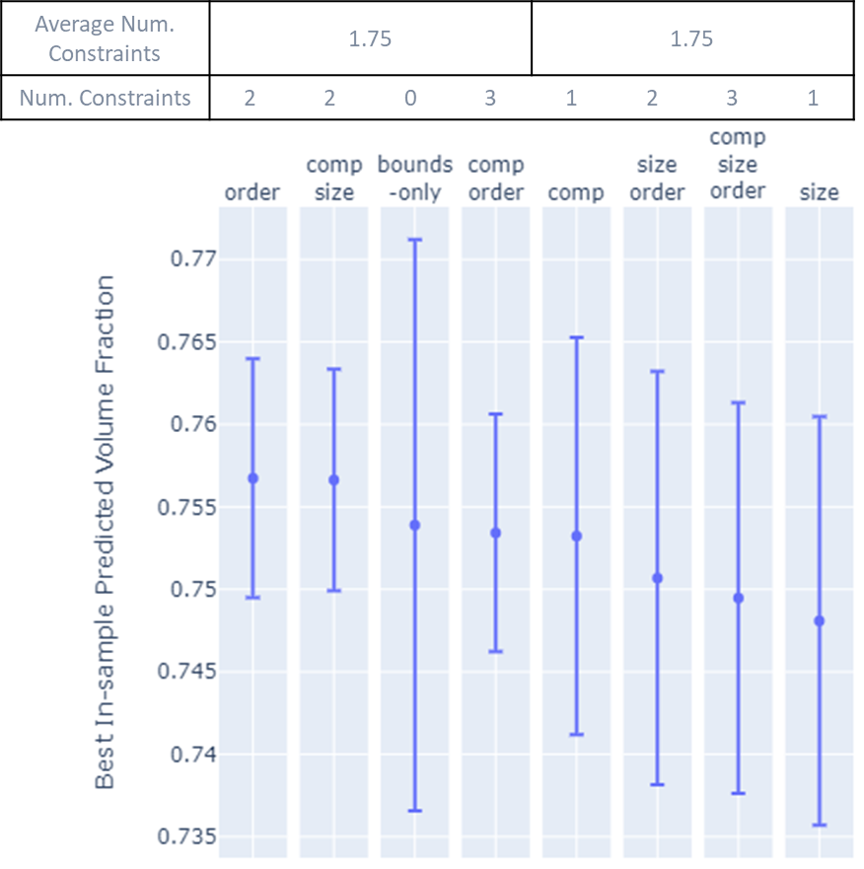

Slide 5
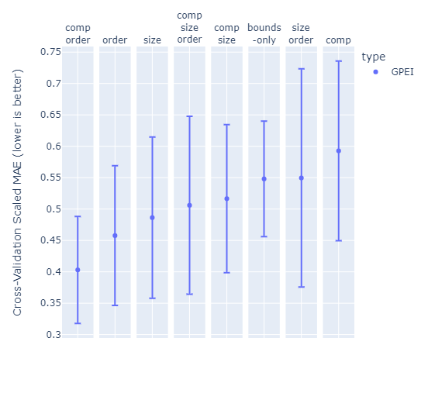
Average Num. Constraints | 2.25 |  |  |  | 1.25
Num. Constraints | 3 | 2 | 1 | 3 | 2 | 0 | 2 | 1

Slide 6
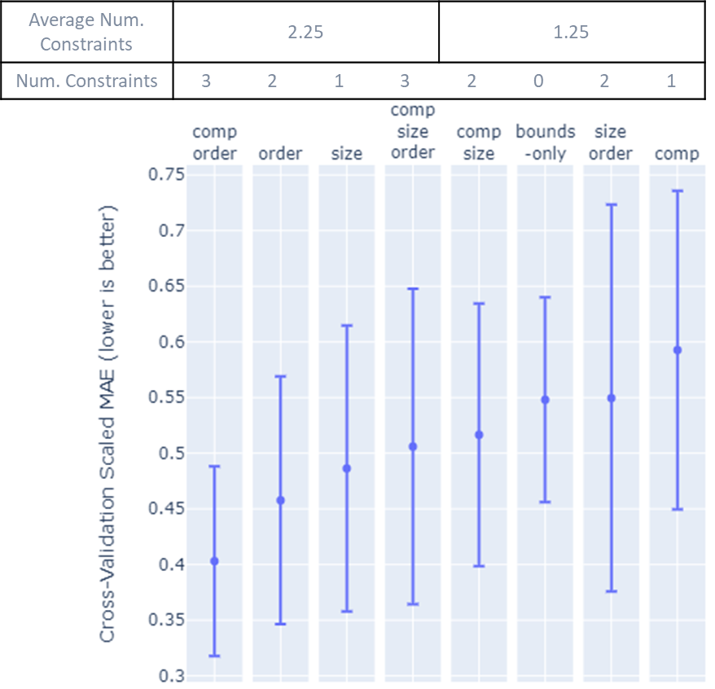

Slide 7
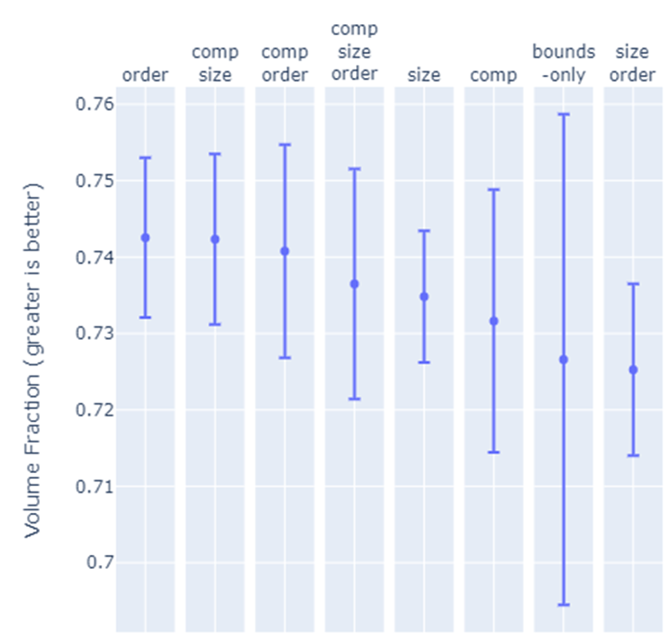
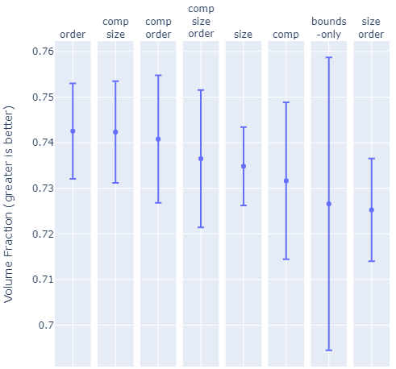
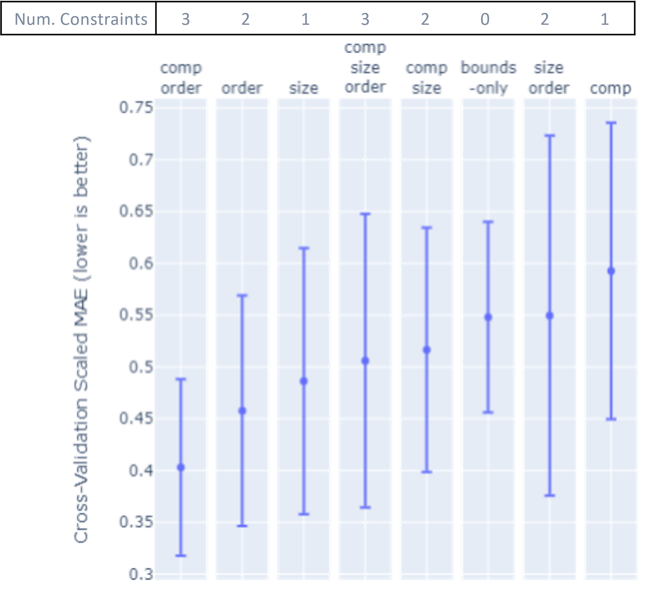
Average Num. Constraints | 2.5 |  |  |  | 1
Num. Constraints | 2 | 2 | 3 | 3 | 1 | 1 | 0 | 2
(a)
Num. Constraints | 2 | 2 | 3 | 3 | 1 | 1 | 0 | 2
(a)
Average Num. Constraints | 1.75 |  |  |  | 1.75
Num. Constraints | 2 | 2 | 0 | 3 | 1 | 2 | 3 | 1
(b)
Num. Constraints | 2 | 2 | 0 | 3 | 1 | 2 | 3 | 1
(b)
Average Num. Constraints | 2.25 |  |  |  | 1.25
Num. Constraints | 3 | 2 | 1 | 3 | 2 | 0 | 2 | 1
(c)
(c)

Slide 8
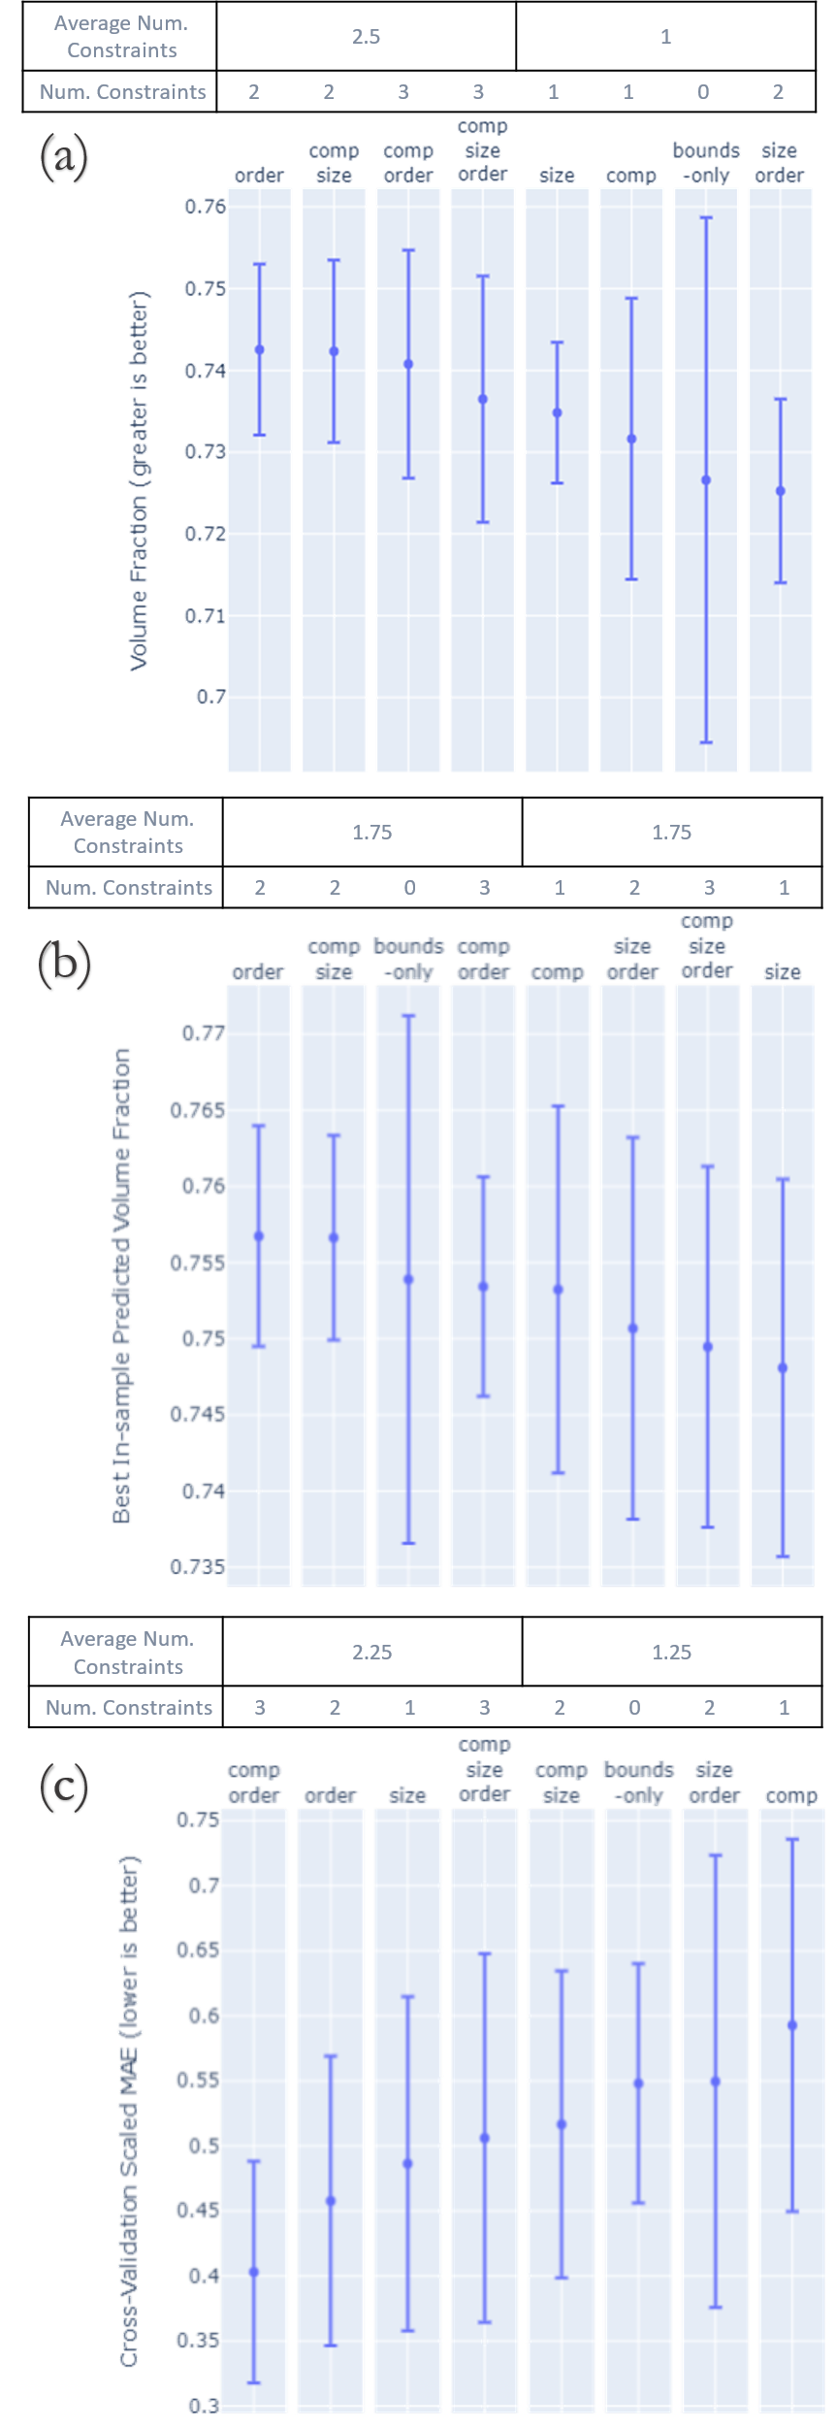

Slide 9


Slide 10


Slide 11
Maximize Packing Fraction via Constrained Bayesian Optimization
Original
Invariant
Size
Composition
Permutation

Slide 12
